Slide 1
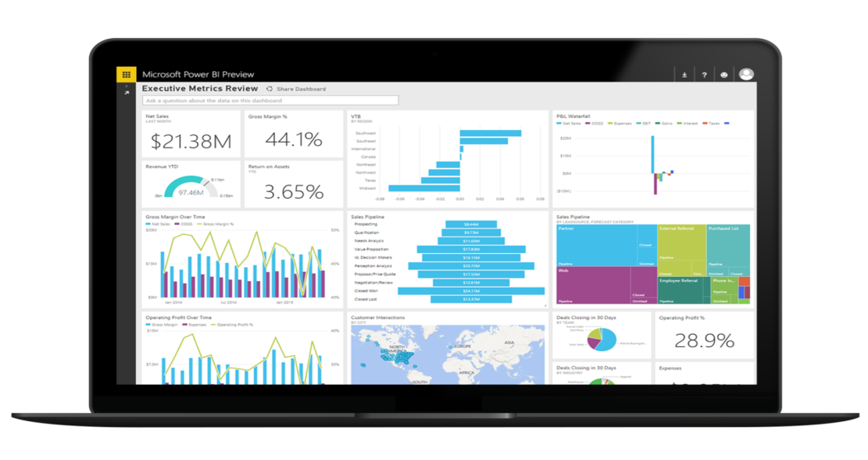

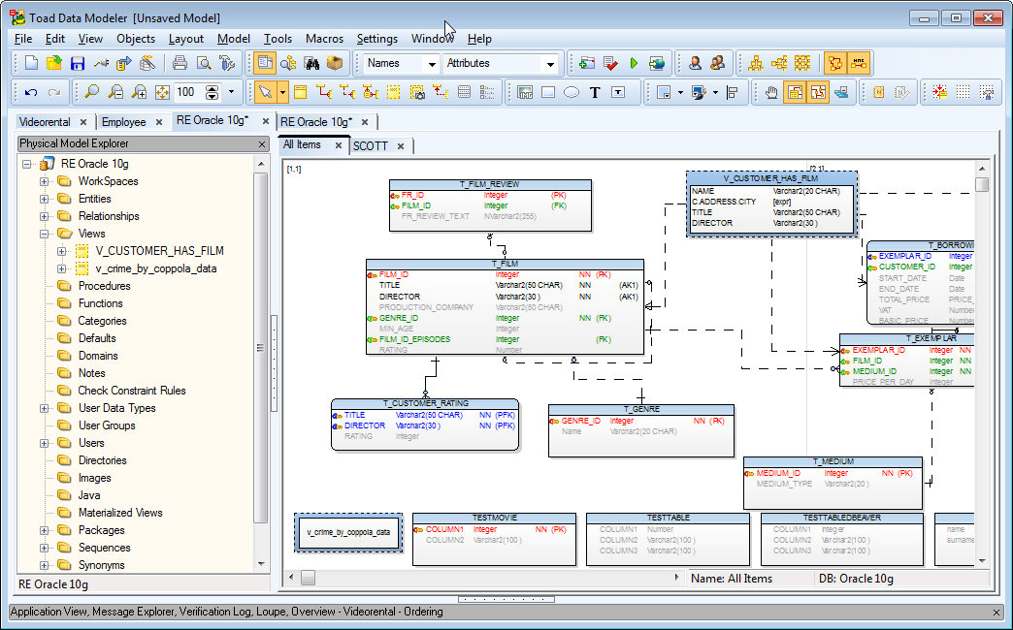



FINAL PROJECT Team 8

Slide 2
Contents
Dimensional Model
Comparison between SQL server, MySQL and Oracle queries
OLAP cubes
Deployment structure of OLAP Cubes
Power BI Dashboards
Challenges

Slide 3
Dimensional Model

Slide 4
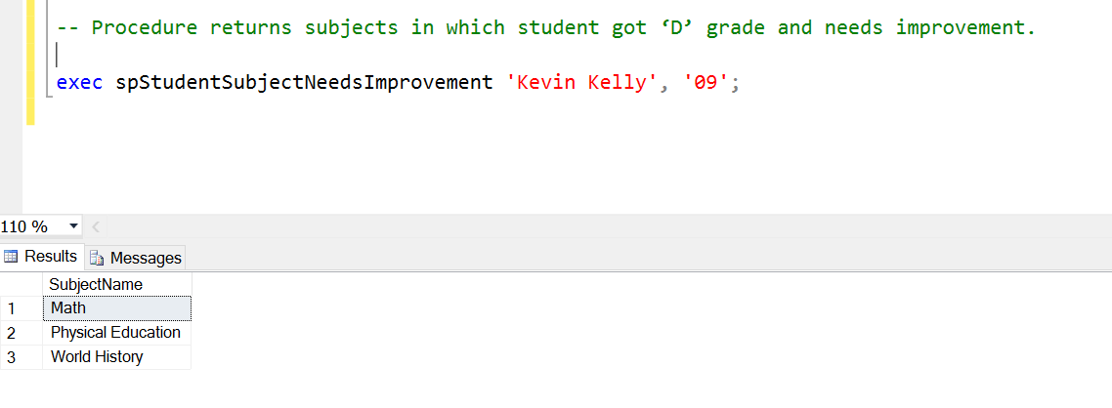
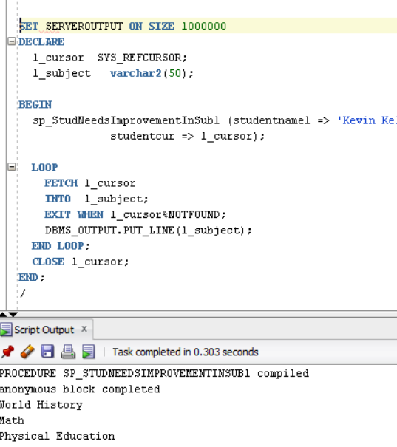
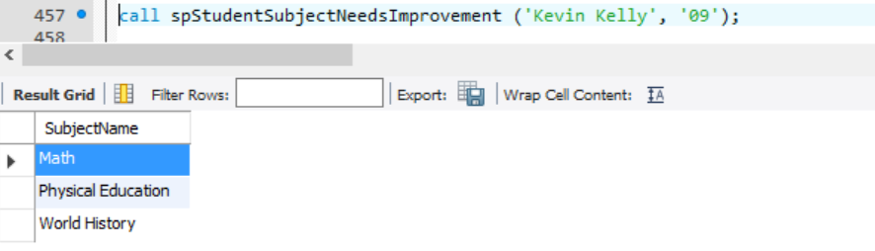
STORED PROCEDURES SQL vs MySQL vs Oracle
SQL server 2014
Oracle
MySQL

Slide 5
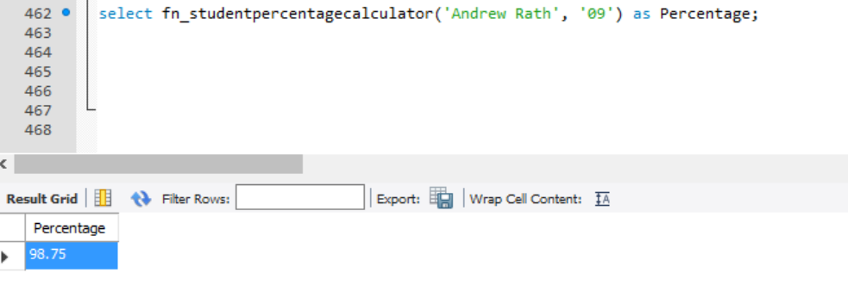
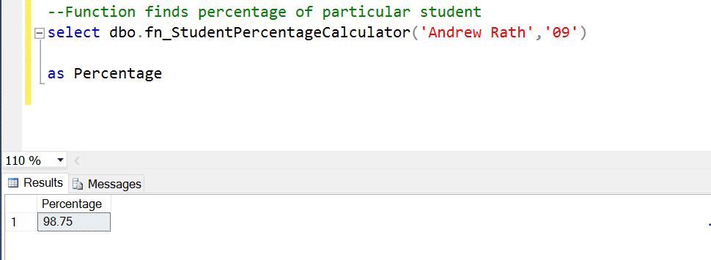
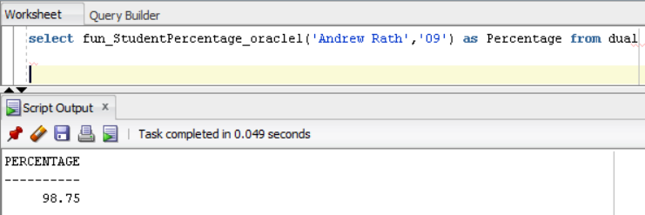
FUNCTIONS MySQL vs SQL vs ORACLE
MySQL
SQL Server 2014
Oracle

Slide 6
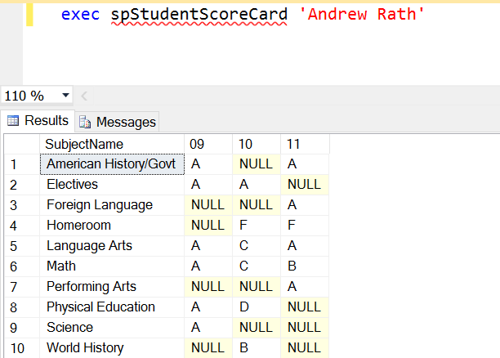
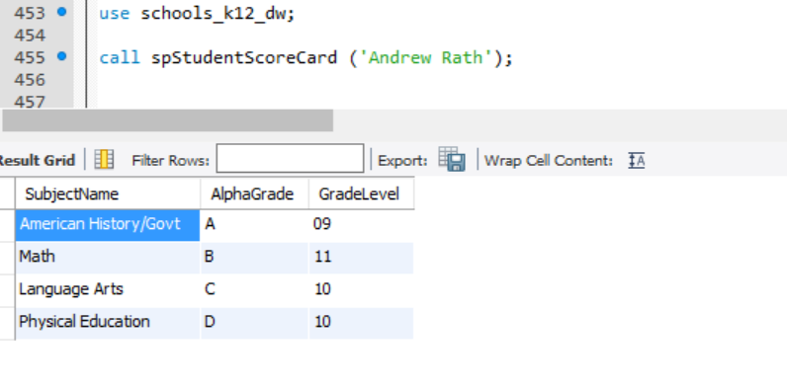
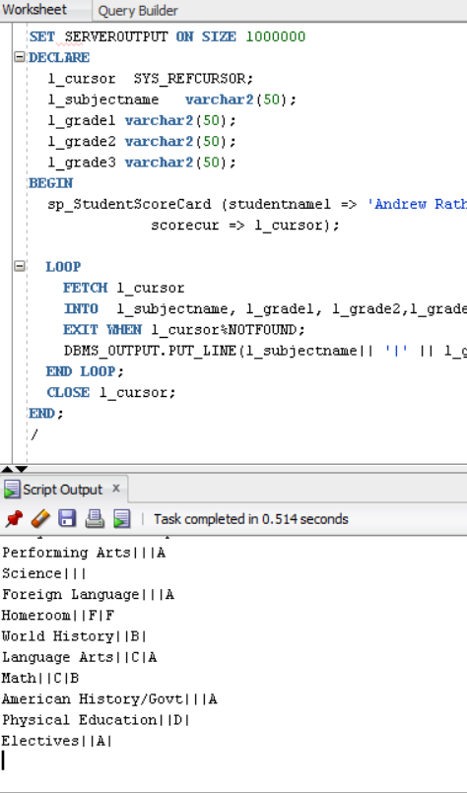
PIVOT TABLE
SQL Server 2014
MySQL
Oracle

Slide 7
Query Links
MSSQL – Queries
MSSQL – Results
MySQL – Queries
MySQL – Results
Oracle – Queries
Oracle – Results
DDL Script MySQL
DDL Script Oracle

Slide 8
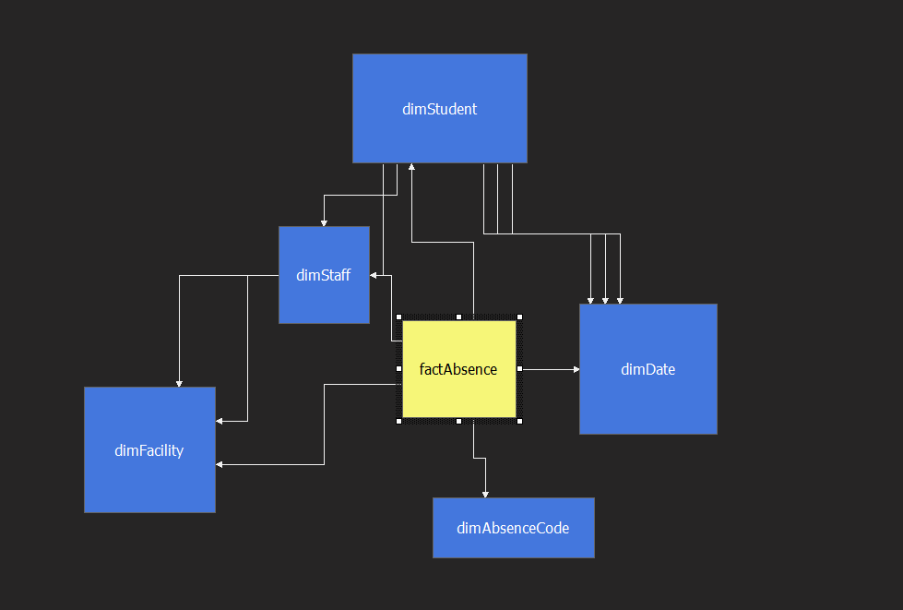
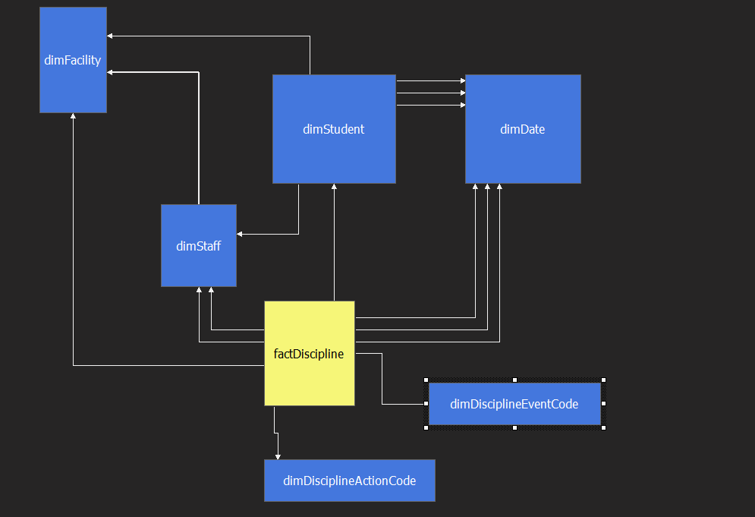
OLAP Cubes
Absence OLAP Cube
Discipline Behavior OLAP Cube

Slide 9
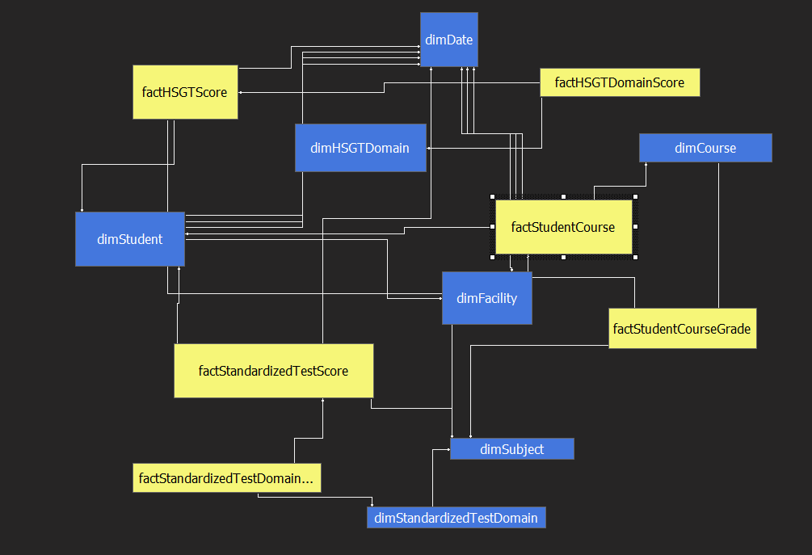
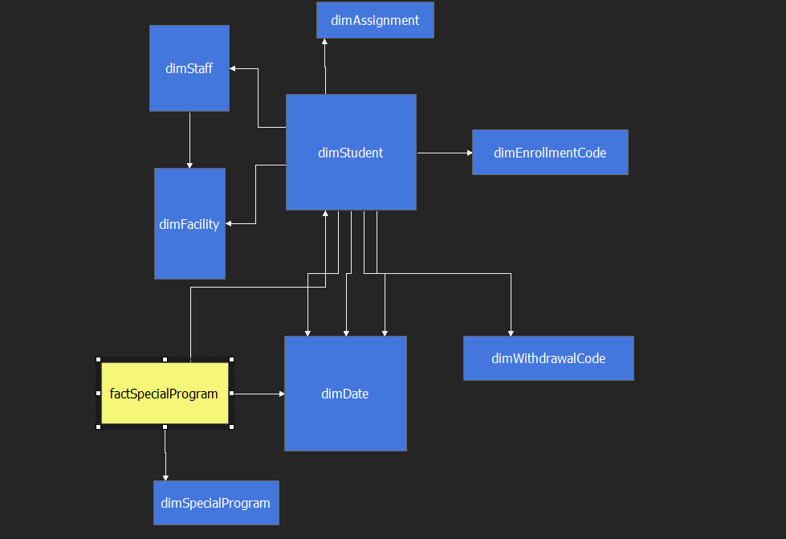
OLAP Cubes(contd)
Academic Performance OLAP Cube
Special Program OLAP Cube

Slide 10
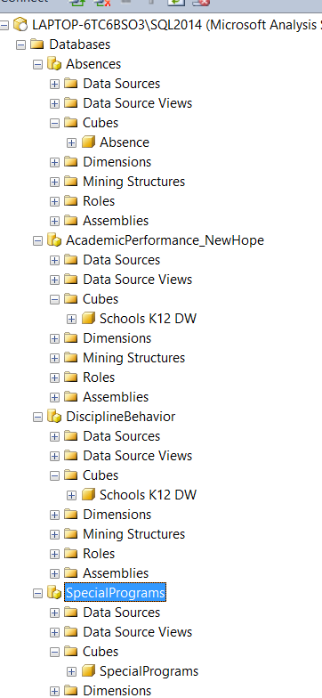
Deployment of OLAP Cubes
Link of abf files
Question 3\OLAPCubes

Slide 11
Power BI Dashboard Links
Absence Dashboard : https://app.powerbi.com/groups/me/reports/028bd427-8247-4f69-a19a-f97436f0b91d/ReportSection1
Discipline Dashboard : https://app.powerbi.com/groups/me/reports/38825b20-f9a2-4020-98f3-ce3d0edf358b/ReportSection2
Special Program : https://app.powerbi.com/groups/me/reports/06e2b13c-3e28-4065-b3b1-fe53cc78a831/ReportSection2

Slide 12
Power BI Dashboard (Academic Performance)

Slide 13
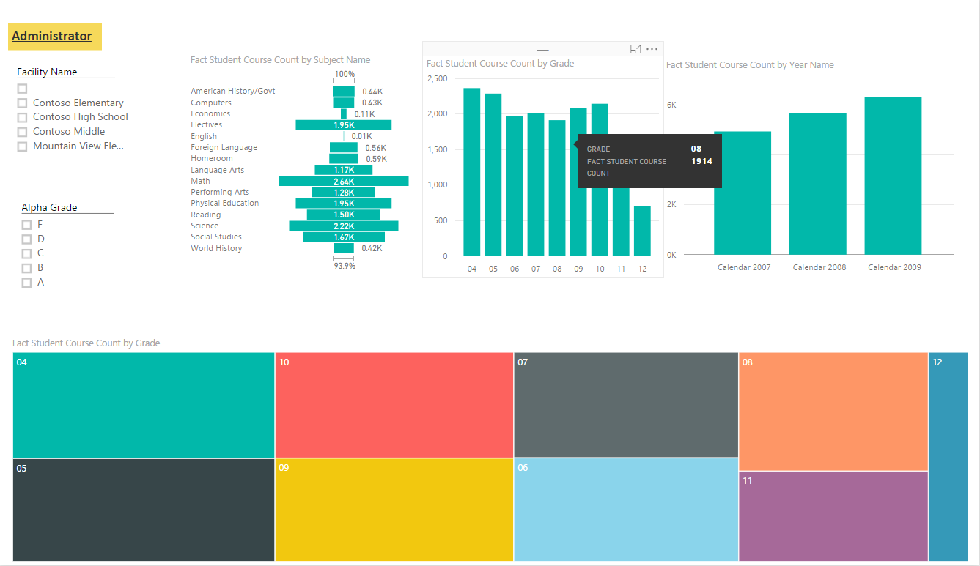

Slide 14
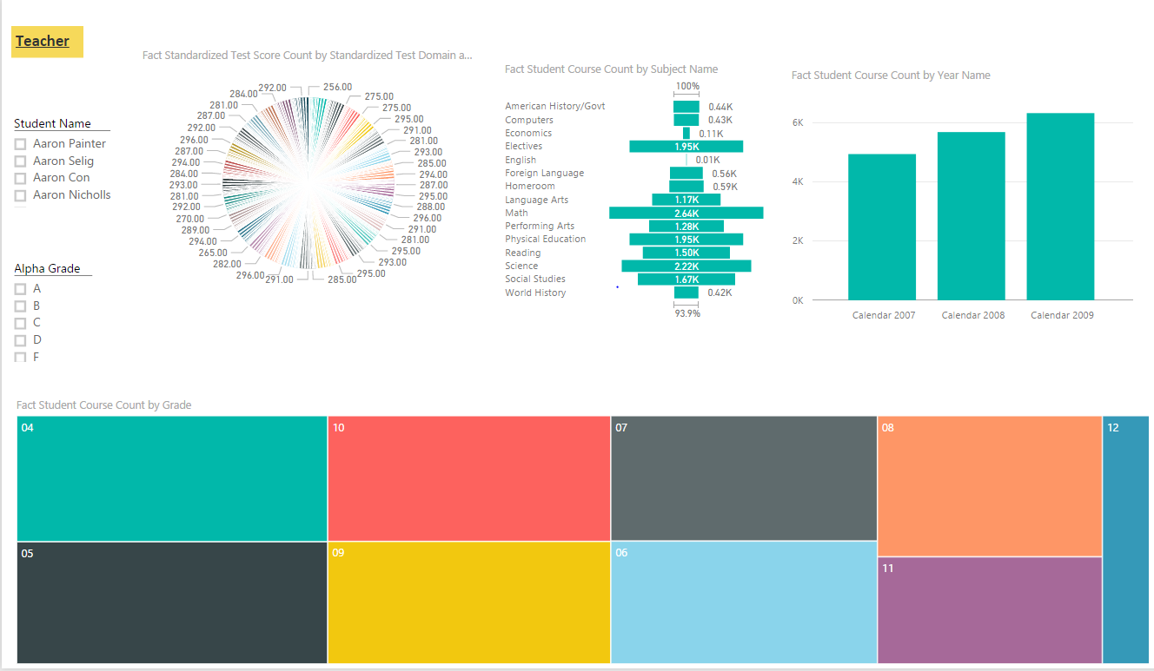

Slide 15
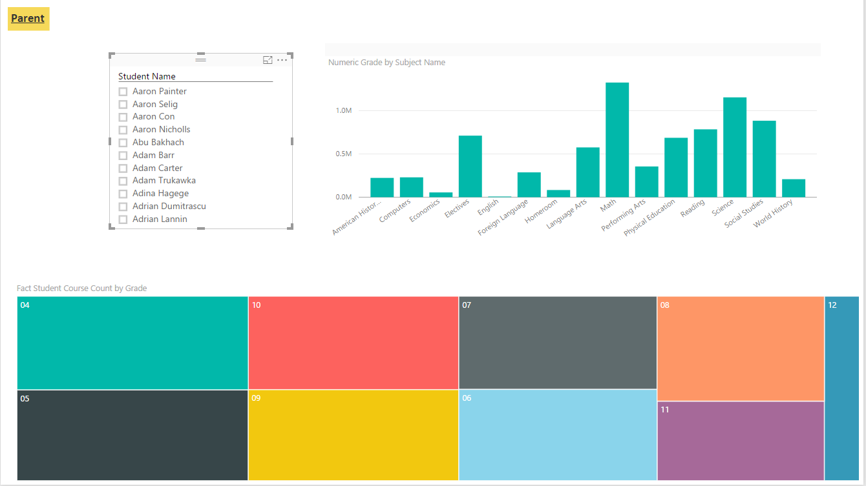

Slide 16
Challenges
Rank function in all 3 DBMS : SQL SERVER 2014, MySQL and Oracle.
Pivot Table in all 3 DBMS : SQL SERVER 2014, MySQL and Oracle.
Stored Procedures and Function syntax in all 3 DBMS.
Performing BI Analysis for Academic Performance.

Slide 17

Arjun Upadhyay (001676292)
Labdhi Shah (001647688)
Vijayashree Uppili (001676934)

